Slide 1



Salva il tuo matrimonio con Azure App Configuration
Fabio Spaziani
Junior Architect @ Blexin

Slide 2











Our Sponsors
2023

Slide 3
Titolo sessione
Agenda
WeBuild 2023
2023

Slide 4


The Ashley Madison problem
Database credentials, Amazon S3, Twitter OAuth tokens, secret tokens for other applications and private keys for SSL certificates
$11.2m settlment class-action
WeBuild 2023
2023
Notes:
Ashley Madison - July 15, 2015 – Amazon S3, Twitter OAuth tokens, secret tokens for other applications and private keys for SSL certificates

Slide 5

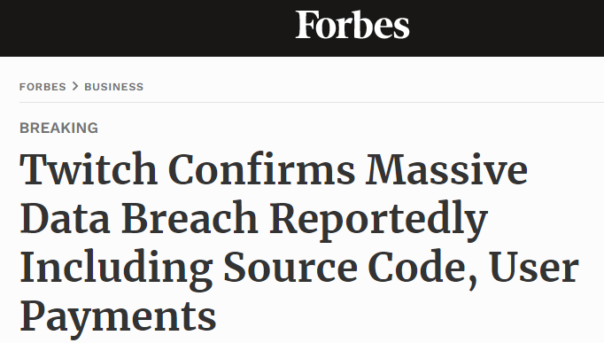
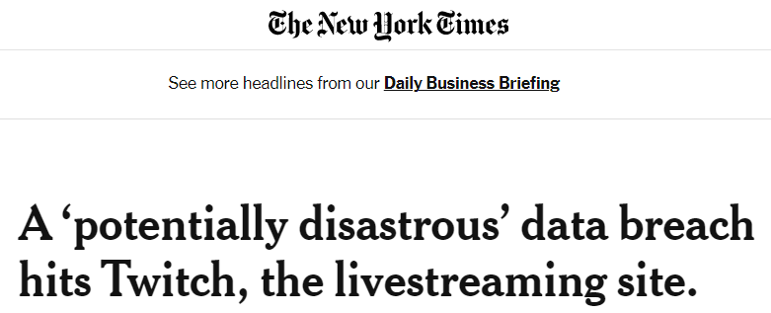
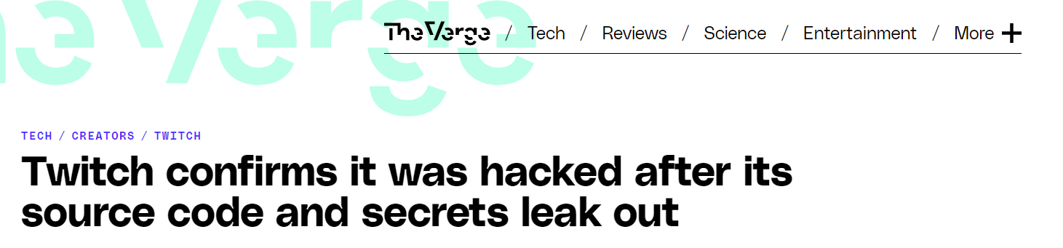
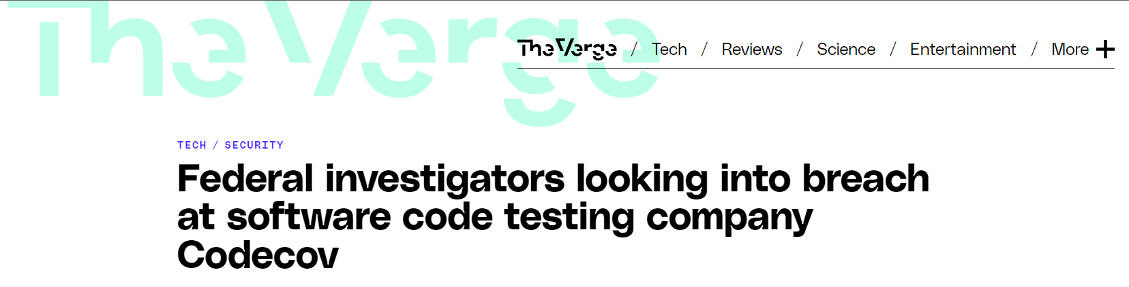

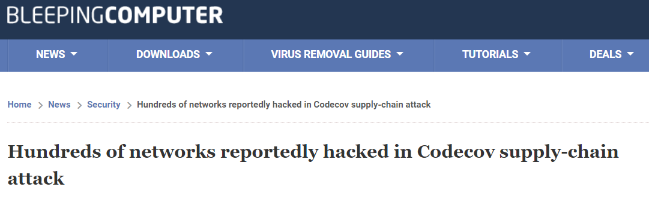

A bigger problem..
[..] Nearly 7,000 secrets including AWS, Google, Stripe, and GitHub keys [..]
WeBuild 2023
2023
Notes:
Twitch – October 2021; 6,000 git repositories of the Twitch codebase leaked this year. Despite lots of evidence demonstrating a certain level of AppSec maturity, nearly 7,000 secrets were uncovered, including hundreds of AWS, Google, Stripe, and GitHub keys,
CodeCov - Between January 31st and April 1st, it was compromised by attackers who were able to extract all the environment variables of Codecov’s customers. Initial access was obtained by extracting a static GCP service account credential from one layer of Codecov Docker image

Slide 6
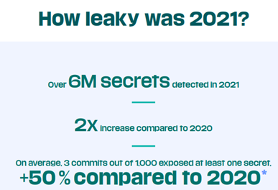

A bigger problem..
Source: Git Guardian State of Secrets Sprawl 2022
WeBuild 2023
2023
Notes:
Twitch – October 2021; 6,000 git repositories of the Twitch codebase leaked this year. Despite lots of evidence demonstrating a certain level of AppSec maturity, nearly 7,000 secrets were uncovered, including hundreds of AWS, Google, Stripe, and GitHub keys,
CodeCov - Between January 31st and April 1st, it was compromised by attackers who were able to extract all the environment variables of Codecov’s customers. Initial access was obtained by extracting a static GCP service account credential from one layer of Codecov Docker image

Slide 7

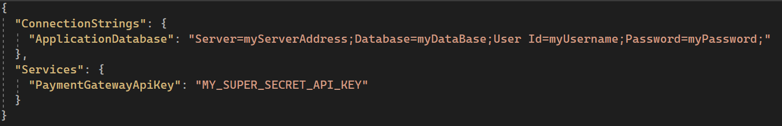



Session Objective
Azure App Configuration
+
Azure Key Vault
WeBuild 2023
2023

Slide 8





Azure App Configuration – Features
Config Store
Feature manager
Stores configuration data as key-value pairs. Multiple values for the same key distinguished by labels.
Decouple feature release from code deployment.
Feature filters capabilities (time windows, targeting, etc.)
Compare & Restore
Security
Permissions via RBAC.
At-rest encryption using customer-managed keys.
Native integration with Azure Key Vault.
Compare and review changes made to the configuration.
Point in time snapshots allows configuration restore.
WeBuild 2023
2023

Slide 9
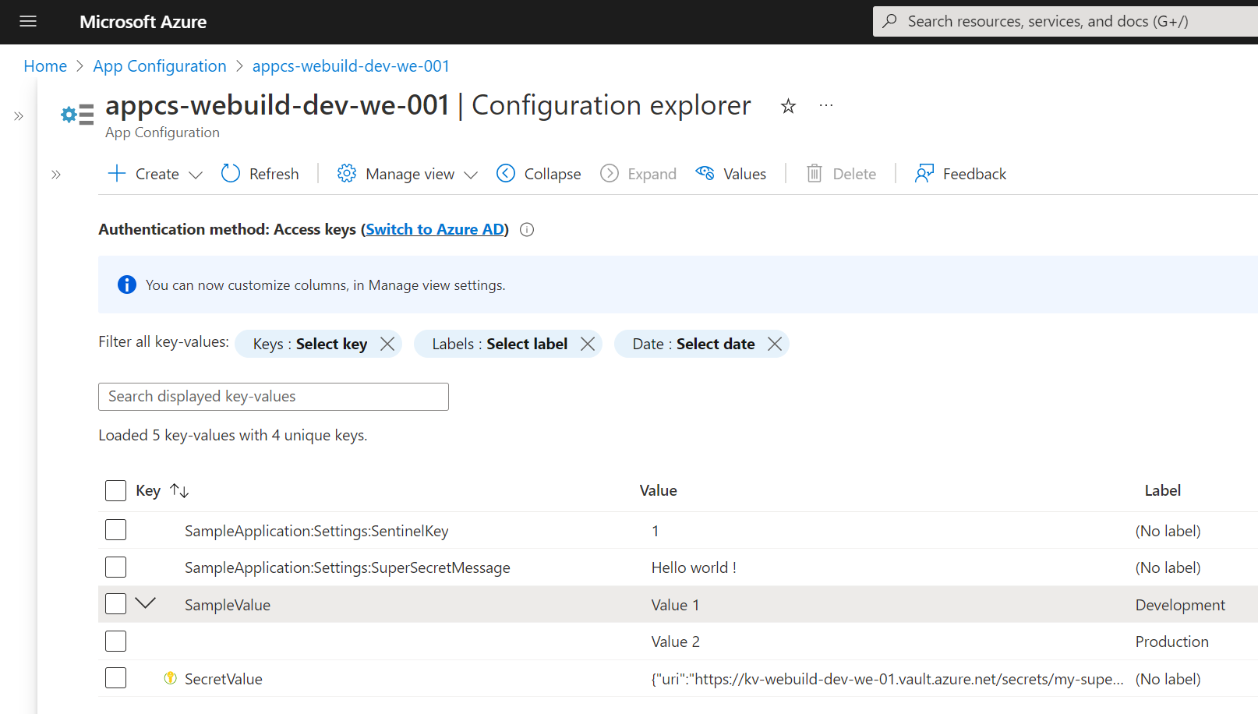
Azure App Configuration – Config Store
Hierarchical configurations
Key grouping (Labels)
WeBuild 2023
2023

Slide 10
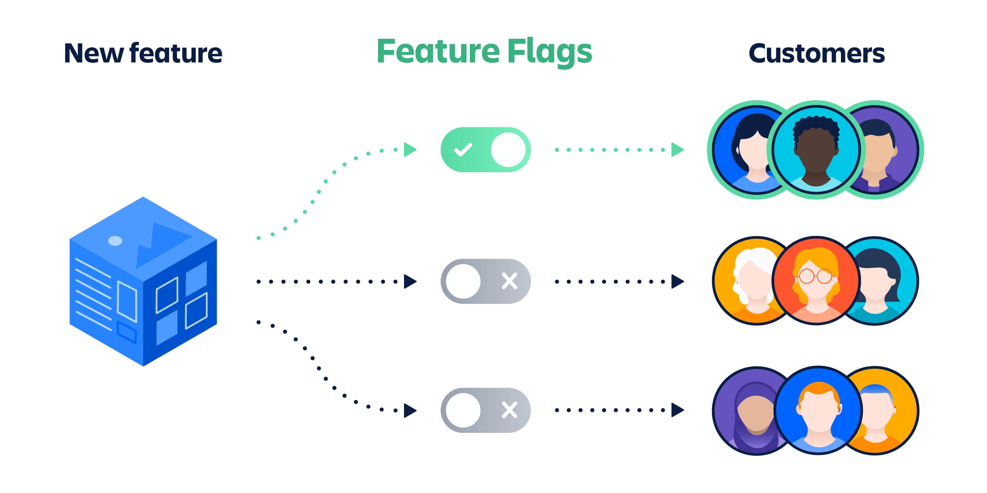
Azure App Configuration – Feature Flags
[Image Source: Atlassian]
WeBuild 2023
2023

Slide 11

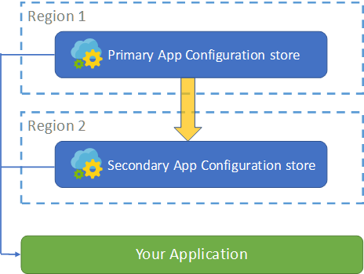


Azure App Configuration – High Availability
Azure App Configuration is a regional service, so can I achieve high availability?
Manual Export + Import
Events + Sync
Geo-Replication (preview)
WeBuild 2023
2023

Slide 12
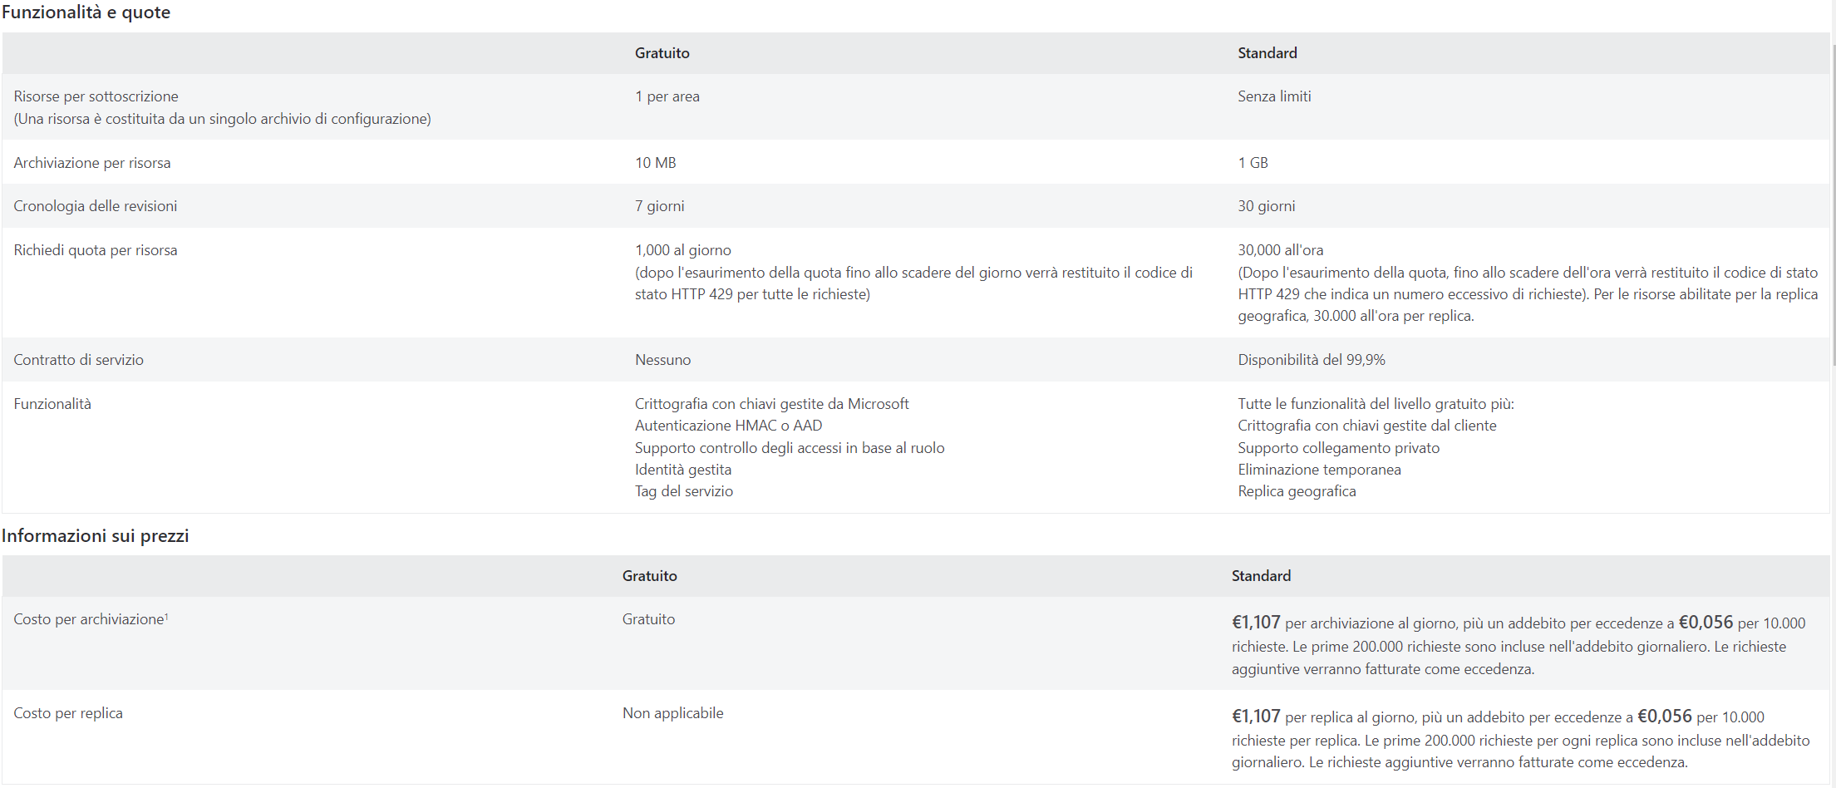
Azure App Configuration – Pricing
WeBuild 2023
2023

Slide 13

Demo Azure App Configuration
WeBuild 2023
2023

Slide 14




Entering Key Vault – Features
Secrets Management
Certificates Management
Azure Key Vault can be used to securely store and tightly control access to tokens, password, certificates, API keys and other secrets.
Azure Key Vault lets you provision, manage, and deploy public and private Transport Layer Security/Secure Sockets Layer (TLS/SSL) certificates.
Keys Management
Hardware Security Modules
Azure Key Vault can be used as a Key Management solution. It makes it easy to create and control the encryption keys used to encrypt your data.
The secrets and key can be protected either by software or validated Hardware Security Modules.
WeBuild 2023
2023

Slide 15



Key Vault – Roles
Vault ownership and control
Controls key lifecycle
Audit review and setup
Define RBAC for permissions
Vault owner
Perform actions on key vault content
Use Access Policies or RBAC for permissions
Allowed actions depends on grants
Vault
Consumers
WeBuild 2023
2023

Slide 16






Key Vault – Integrations
Azure Disk Encryption
Storage Account
Transparent Data Encryption Azure SQL Db
Github Actions
App Services
Azure DevOps
WeBuild 2023
2023

Slide 17

Key Vault – High availability and prices
Availability and redundancy
Pricing
Standard Plan
Premium Plan
Contents of you Key Vault are always replicated within the region (Azure paired regions).
Keys, secrets and certificates access (price per 10,000 transaction)
If the Azure region is unavailable, the requests that you make of Azure Key Vault in that region are automatically routed (failed over) to a secondary region
Certificates and keys rotation
When the primary region is available again, requests are routed back (failed back) to the primary region.
HSM Protected Keys
WeBuild 2023
2023

Slide 18
Key Vault Demo
WeBuild 2023
2023

Slide 19
Why should you use Azure App Configuration and Azure Key Vault?
Centralize application configurations
Store and manage securely secrets, keys and certificates
Decouple Secrets owners from Secrets users (applications)
Easily migrate from appsettings
Plenty of integrations available out of the box
Not to piss off your partner
1
2
3
4
5
6
WeBuild 2023
2023

Slide 20



Q&A
Questions?
{
"Name": "Fabio Spaziani",
"Role": "Junior Architect @ Blexin"
}
WeBuild 2023
2023

Slide 21

Questions
&
Answers

